Slide 1
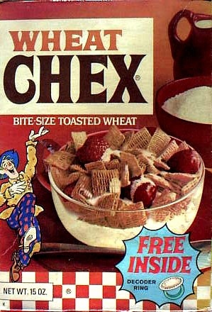
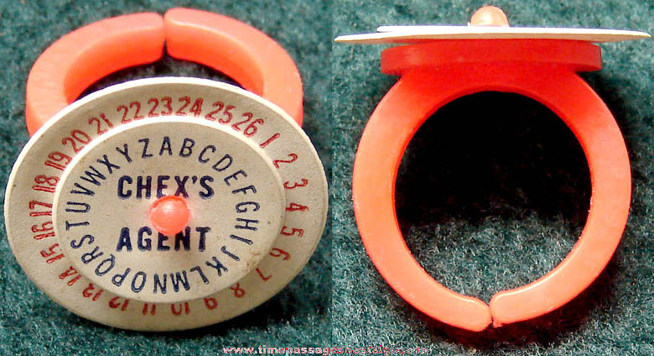
0x101 – Security in History Basic Ciphers
ECED4406 – Computer Security
Dr. Colin O’Flynn
Dalhousie University.

Slide 2
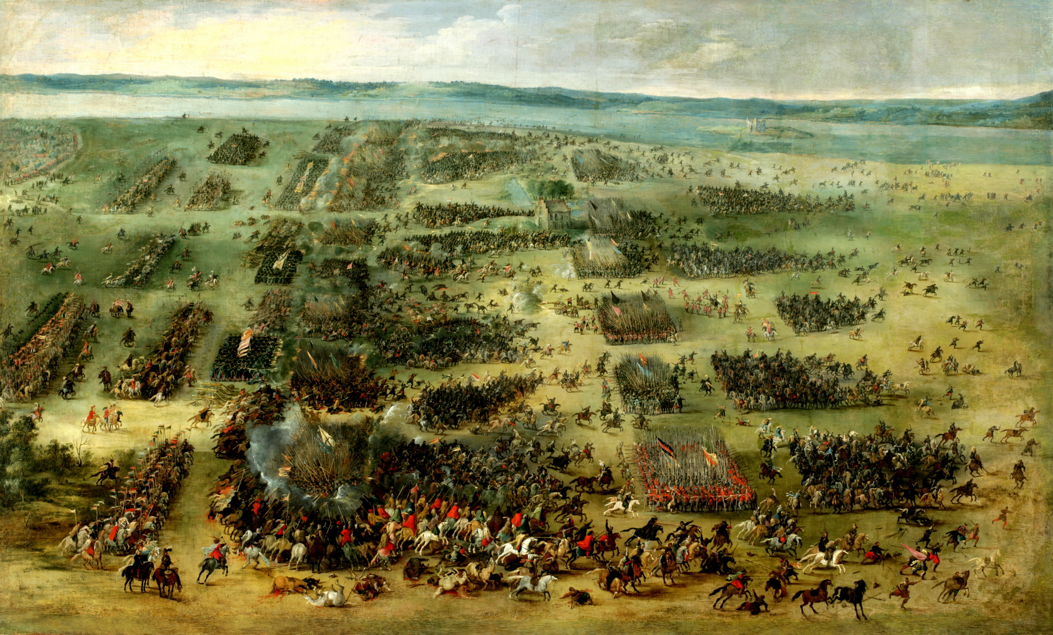
War

Slide 3
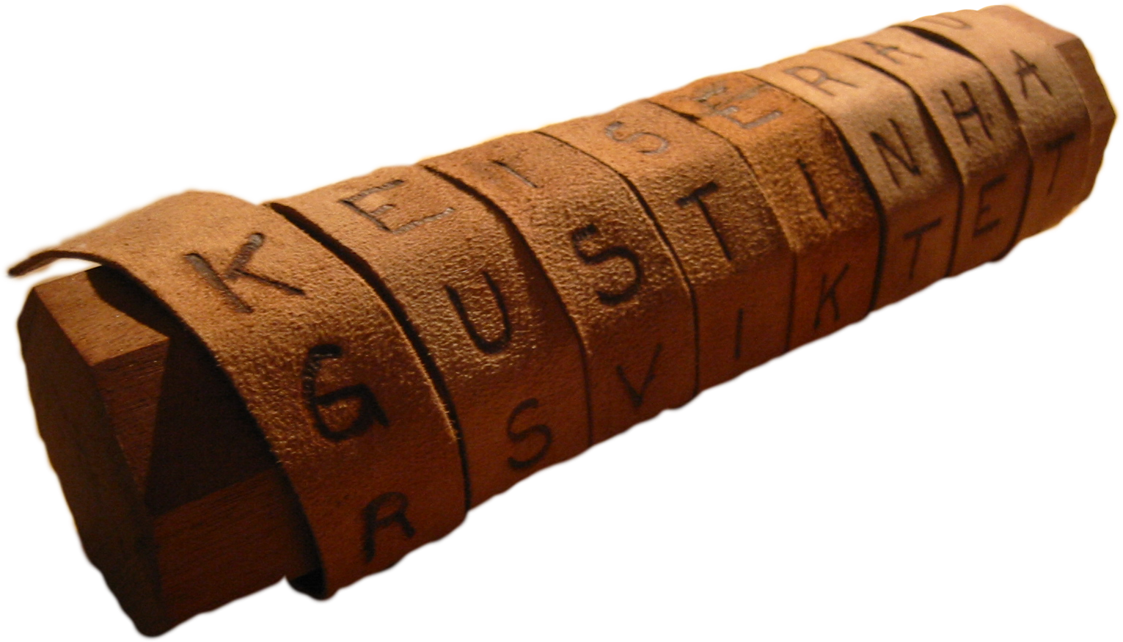
Scytale Cipher

Slide 4
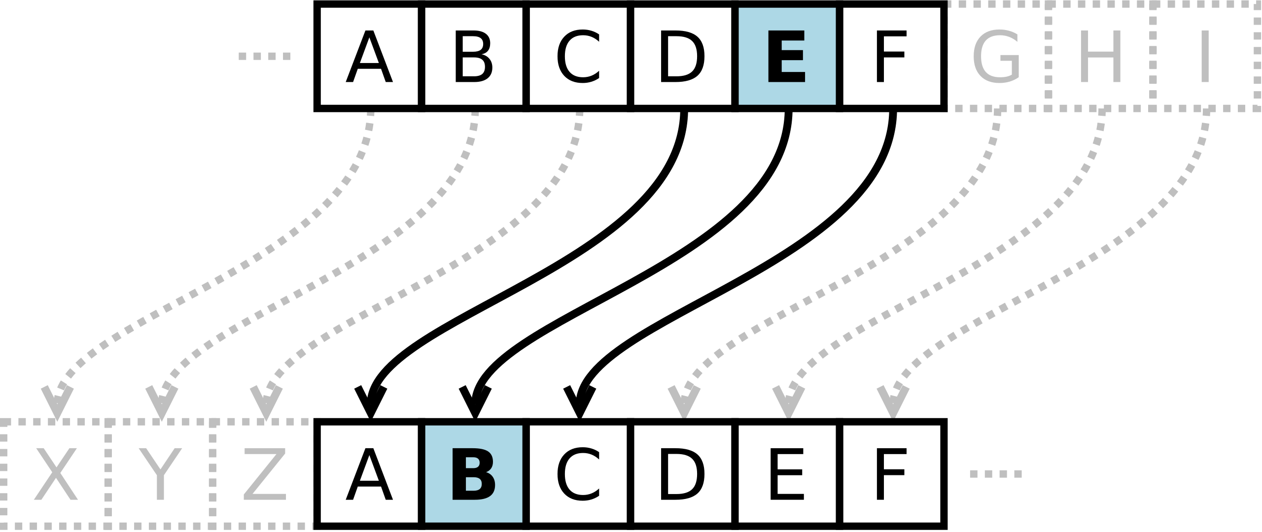
Caesar Cipher

Slide 5
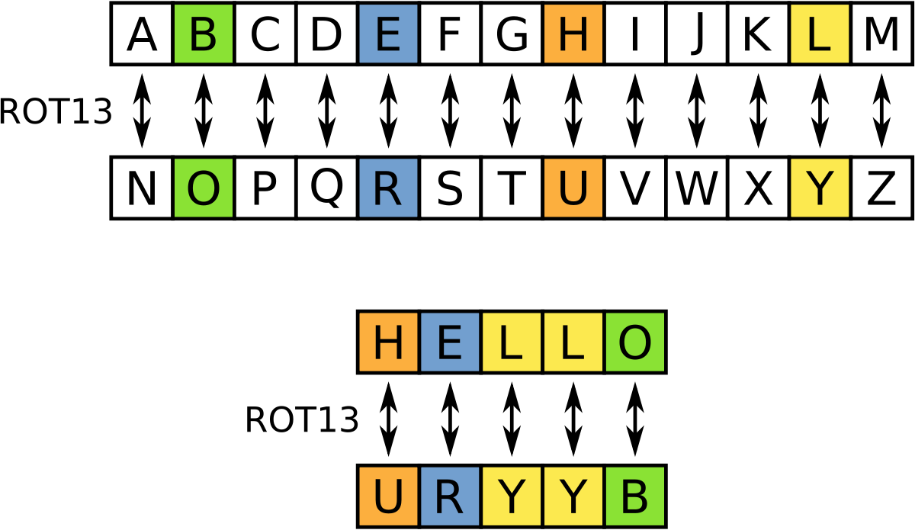
Example: Rotate by 13 places (ROT-13)

Slide 6
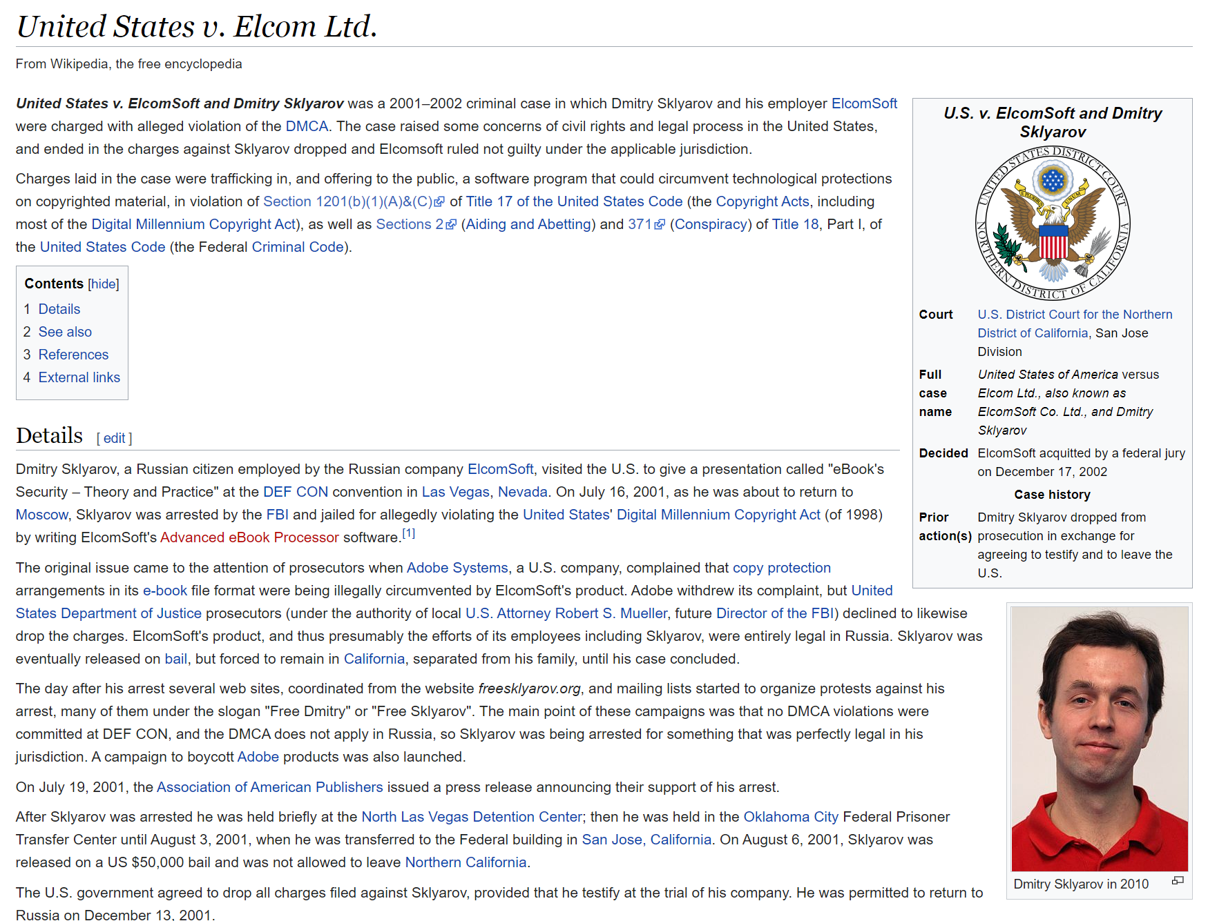
…but that’s old right???
https://en.wikipedia.org/wiki/United_States_v._Elcom_Ltd.

Slide 7
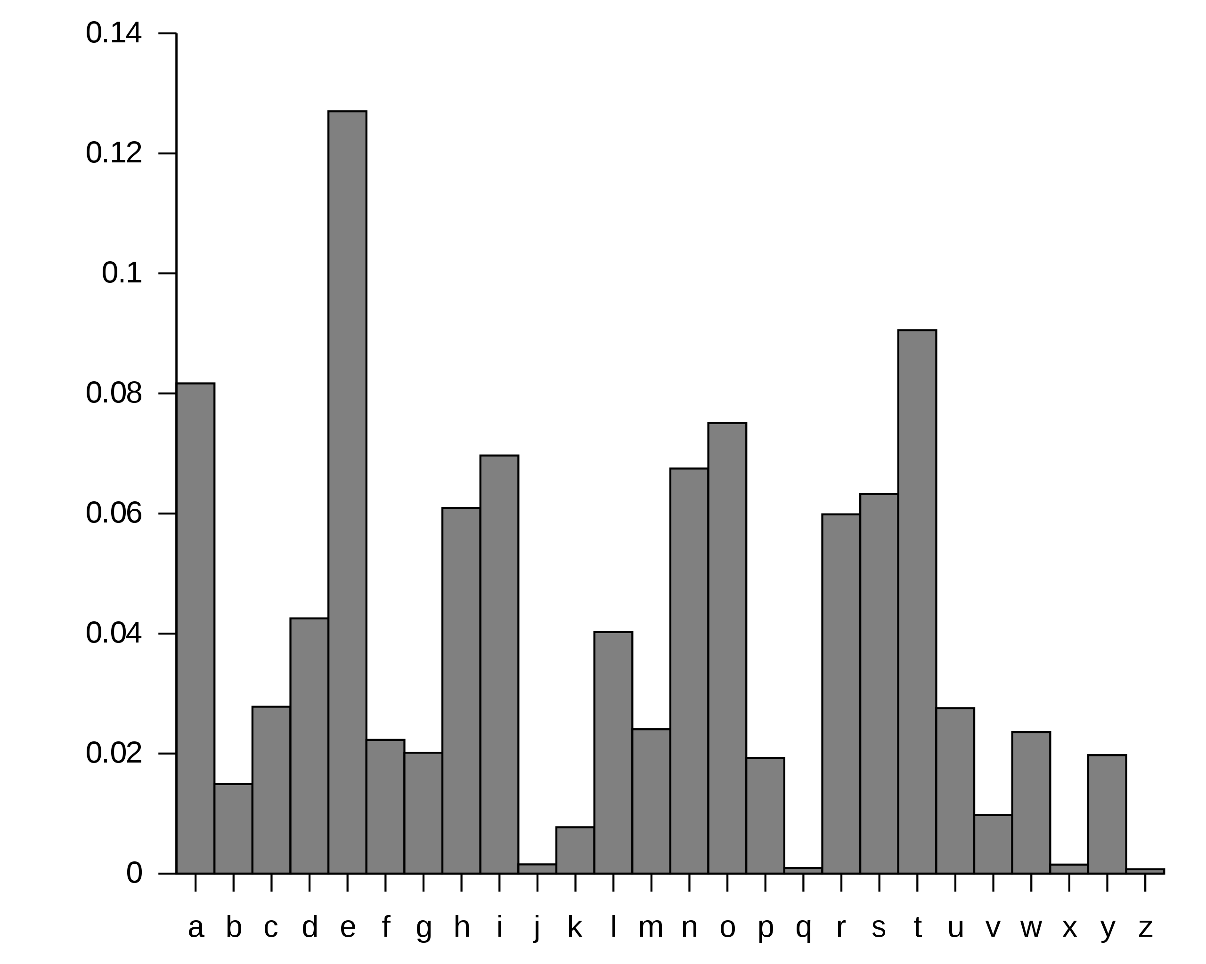
Cipher Security?

Slide 8
Example of Cipher Decryption
Olssv LJLK Jshzz Mvby Mvby Glyv Zpe
https://www.dcode.fr/caesar-cipher

Slide 9
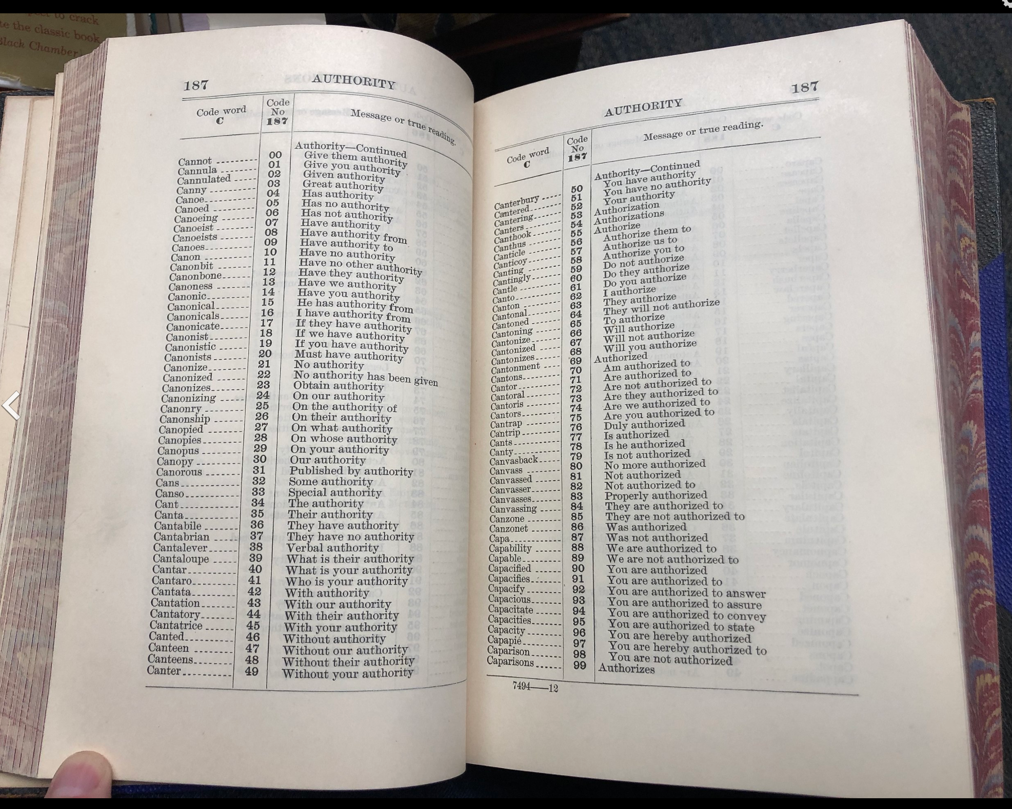
Code Book
Theoretically unbreakable! Random words assigned to other words or numbers.
You need the corresponding code book to decode it.
…you need a secure channel for the code book. Need many updates to them during a war.

Slide 10
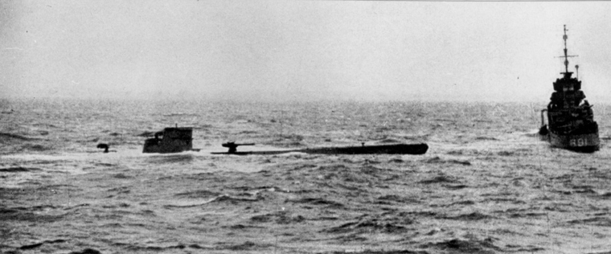
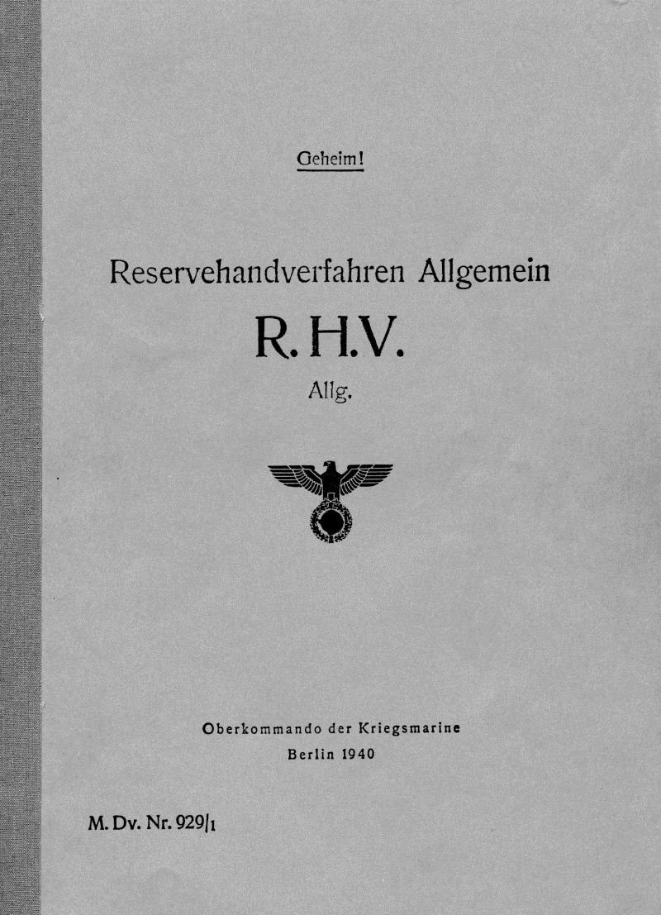
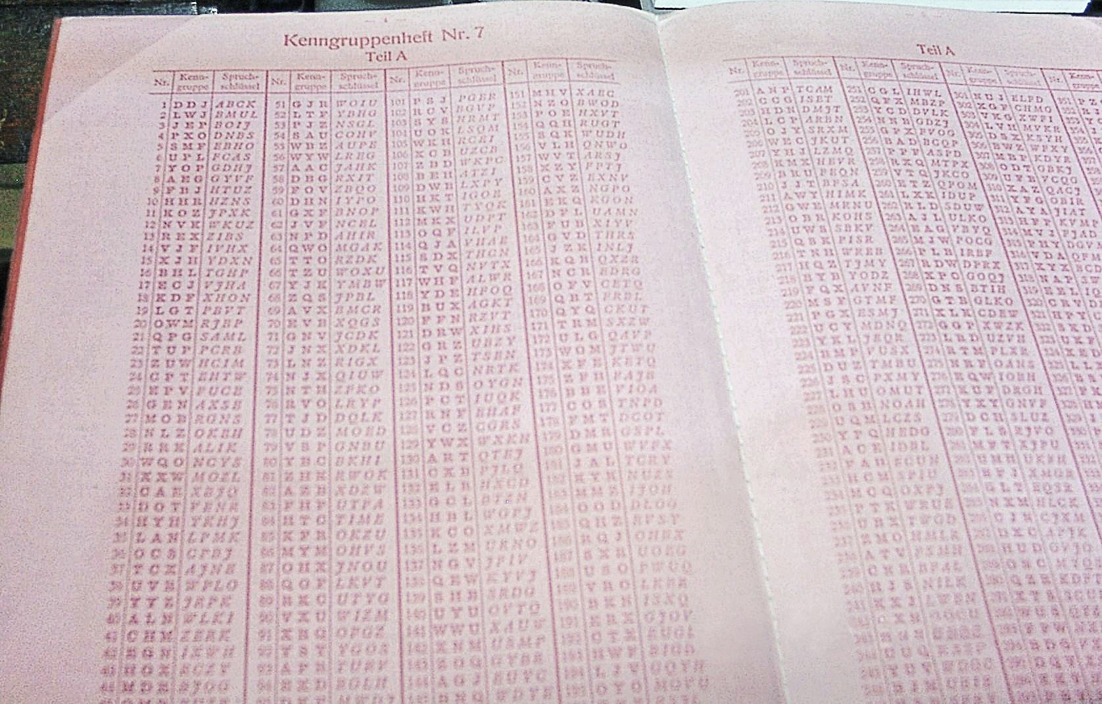
Example – Various Ciphers from U110 Capture
https://en.wikipedia.org/wiki/Kurzsignale
https://en.wikipedia.org/wiki/Reservehandverfahren
Documentary on U110: https://www.youtube.com/watch?v=K6R52Xhh0_I
https://en.wikipedia.org/wiki/German_submarine_U-110_(1940)

Slide 11
On Bording Party (from Wikipedia)
“Bulldog's boarding party, led by sub-lieutenant David Balme, got onto U-110 and stripped it of everything portable, including her Kurzsignale code book and Enigma machine.^{[5]} William Stewart Pollock, a former radio operator in the Royal Navy and on loan to Bulldog, was on the second boat to board U-110. He retrieved the Enigma machine and books as they looked out of place in the radio room. U-110 was taken in tow back toward Britain, but sank en route to Iceland.”

Slide 12
Number Stations
Example of good usage of code books – “number stations” transmit words in the clear to *everyone*. Only agents with codebook can understand.
Example of https://www.youtube.com/watch?v=GNnPPQU9c-c&t=47s
Very famous & interesting one is UVB-76
See https://en.wikipedia.org/wiki/UVB-76
Running since 1973, still running today.
Mostly beeps / buzzes (that change).
Sometimes talking has been broadcast.
Often number/letter sequence (as recently as August 24 / 2020).
Listen to it live: https://www.youtube.com/watch?v=LegzZZRIqj4

Slide 13
Historical Ciphers
Normally based on substitutions, code books, etc.
Easy to break with computers (luckily those didn’t exist then).
Reasonable to break even with humans however often…
Usage of code books made them high suspectable to capture of the code book
→ Once one book captured, system could be lost!

